Slide 1
AePR: AAEEBL’s ePortfolio Online Journal
Cindy P. Stevens, Ph.D. Executive Co-Editor, Wentworth
Samantha J. Blevins, Ph.D. Style Editor, Radford
Adam N. Wear
New Managing Co-Editor

Slide 2
Our Full Team
Executive Co-Editor Cindy Stevens, Wentworth Institute of Technology
Executive Co-Editor David R. Dannenberg, University of Alaska Anchorage
Managing Editor Russel Stolins, Institute of American Indian Arts
Review Editor Coordinator Adam Wear, University of North Texas
Review Editor Coordinator Barbara Ramirez, Clemson University
Design and Production Nami Okuzono, Institute of American Indian Arts
APA Style Editor Carra Hood, Stockton University
Style Editor Samantha J. Blevins, Radford University
Social Media Editor Candyce Reynolds, Portland State University
Web Editor Dirk Matthews, Columbia College Chicago

Slide 3
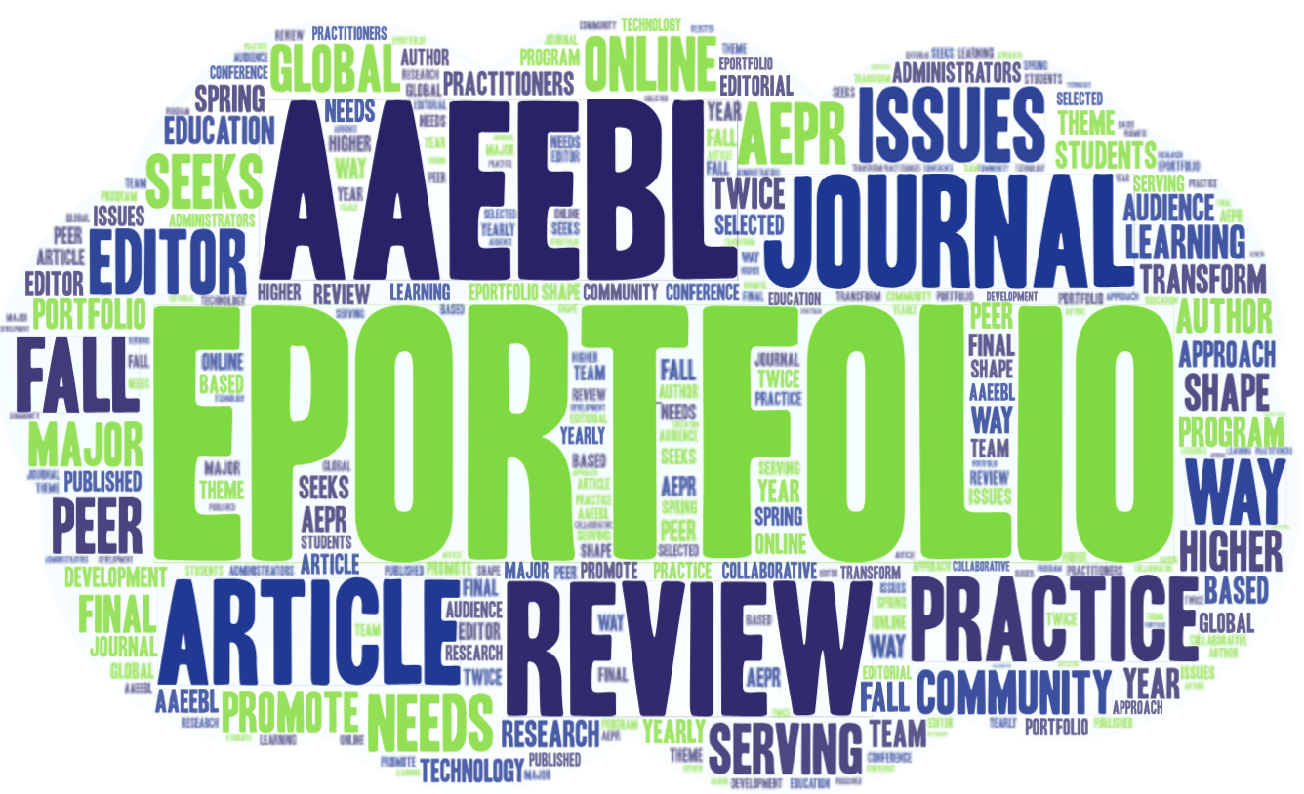
AePR’s Vision
Notes:
The AAEEBL ePortfolio Review (AePR) is AAEEBL’s online journal serving the needs of the global eportfolio community and seeks to promote portfolio learning as a major way to transform higher education.
Peer-reviewed journal
Audience is eportfolio practitioners, administrators, and students
Articles about research, technology, program development and practical issues in ePortfolio practice
Collaborative author/editor approach
Editors can shape final article
Published twice a year (Spring and Fall)
Issues based on theme
Selected by editorial team
Fall 2018 - AAEEBL’s yearly conference

Slide 4
Our Approach
Authors/ Editors Process
Paired with an editor
Styles editor
APA editor
Full Team Proofing
Full team review
Board review
Second full team review

Slide 7
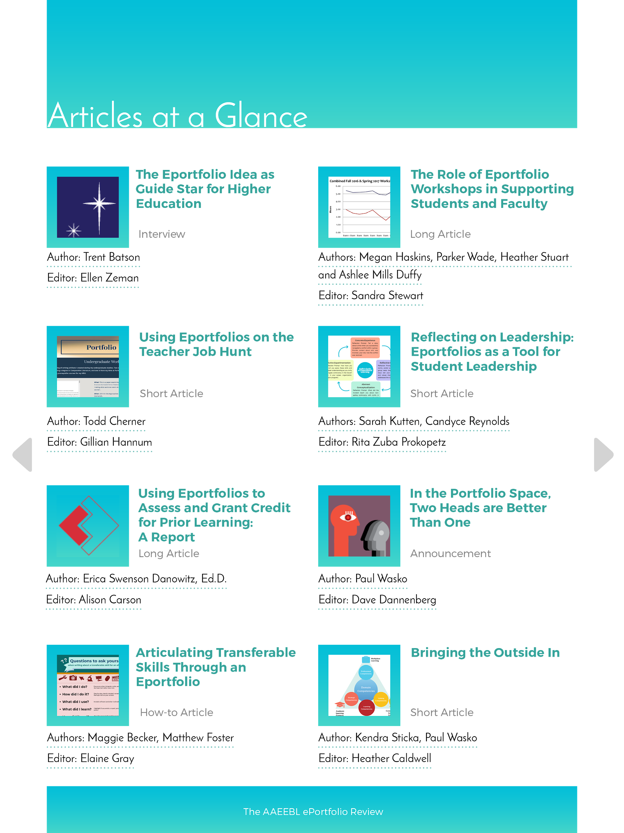

Slide 8
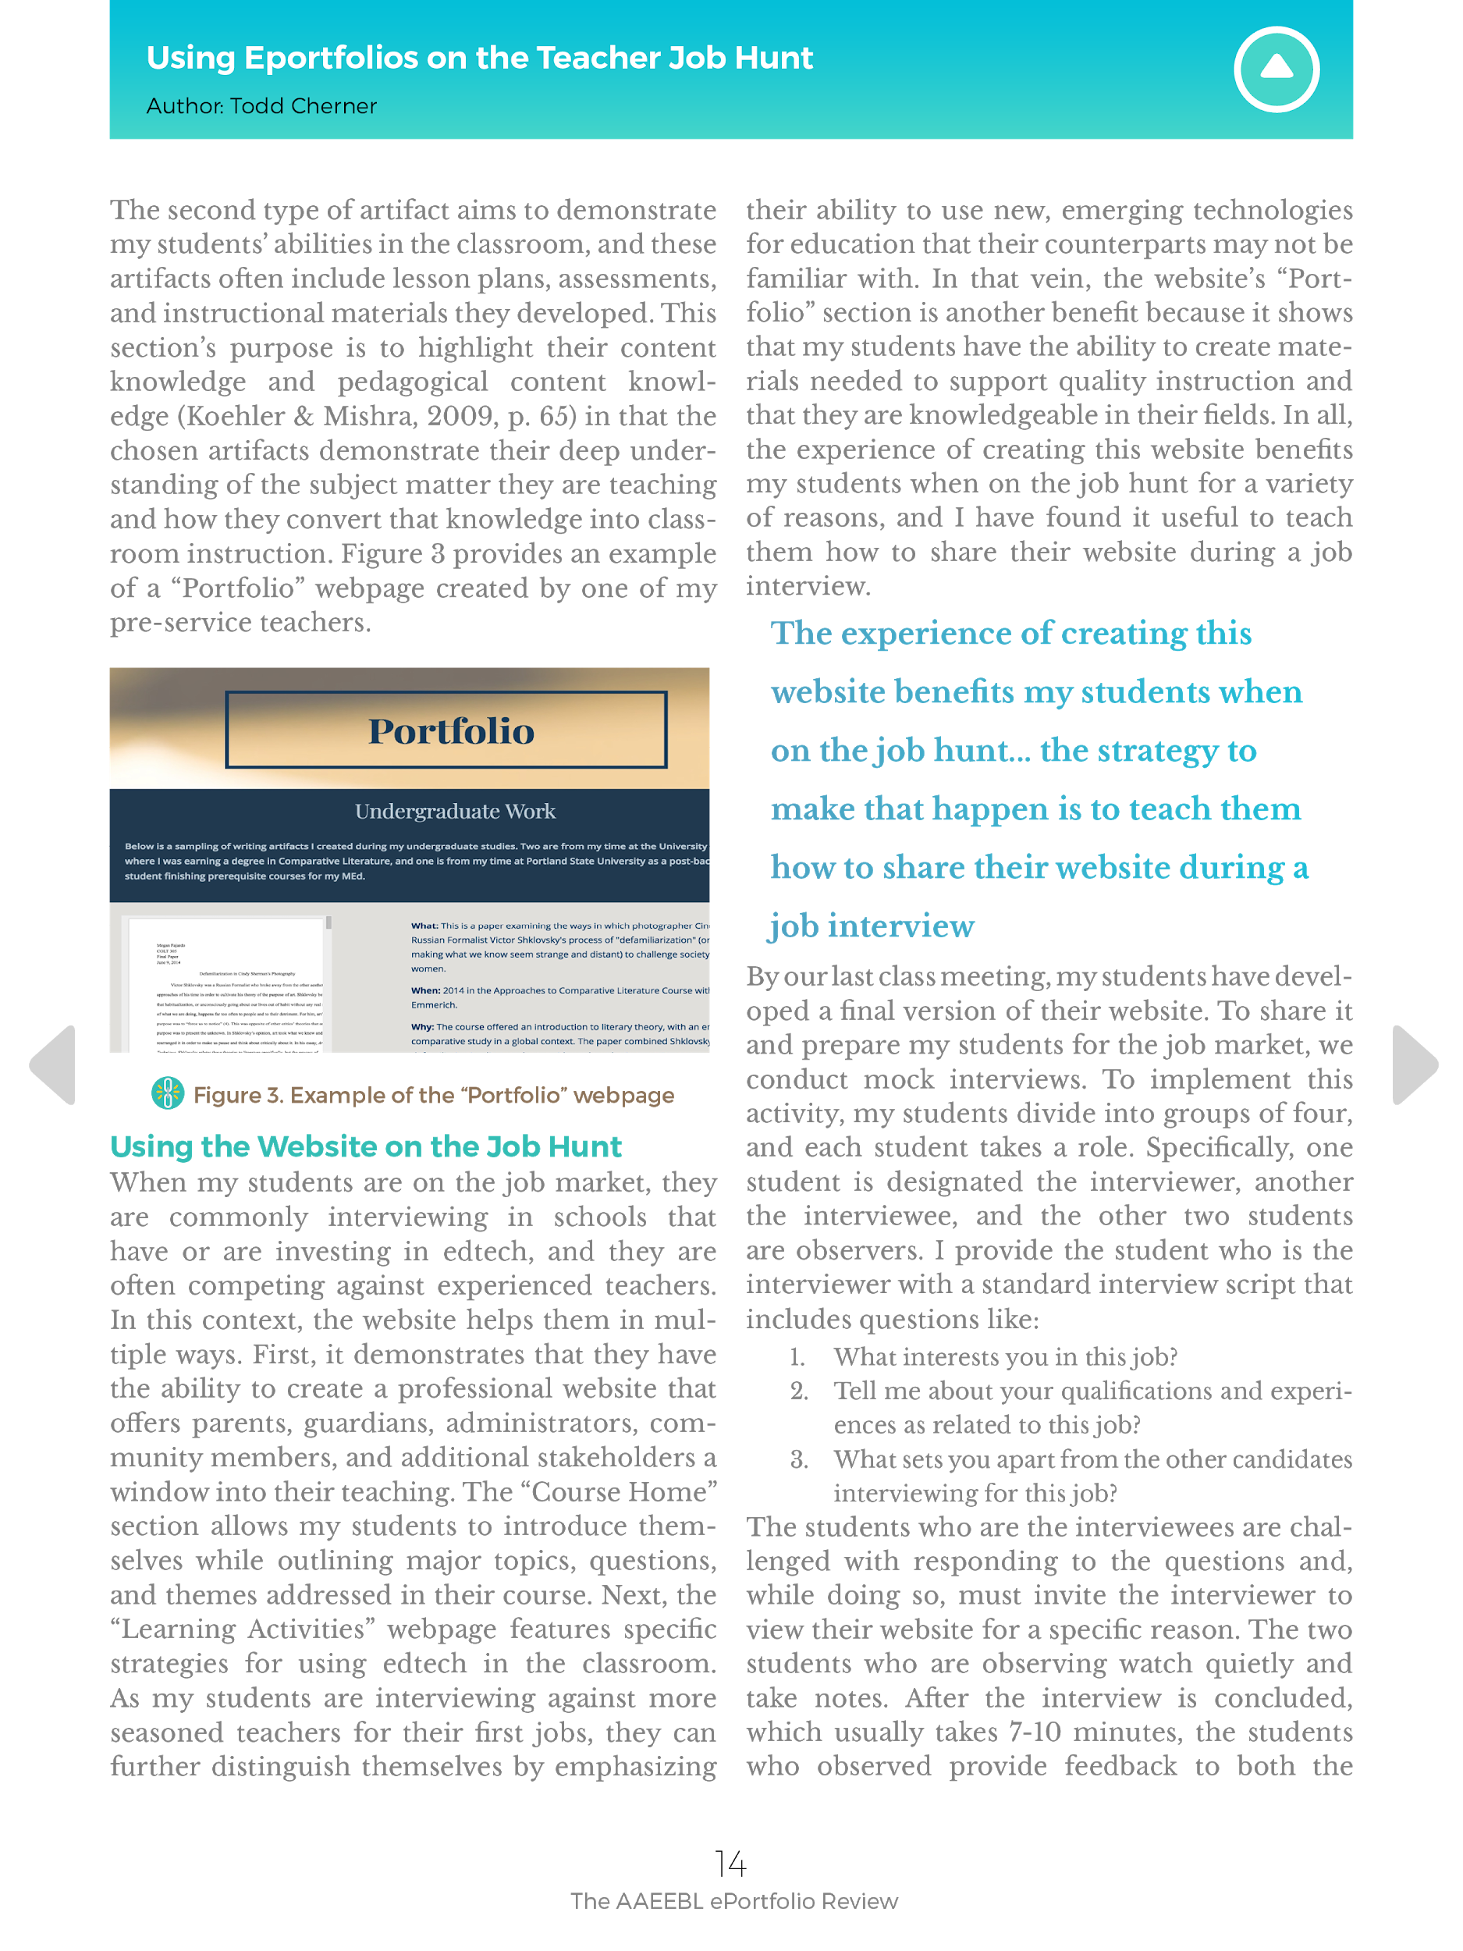
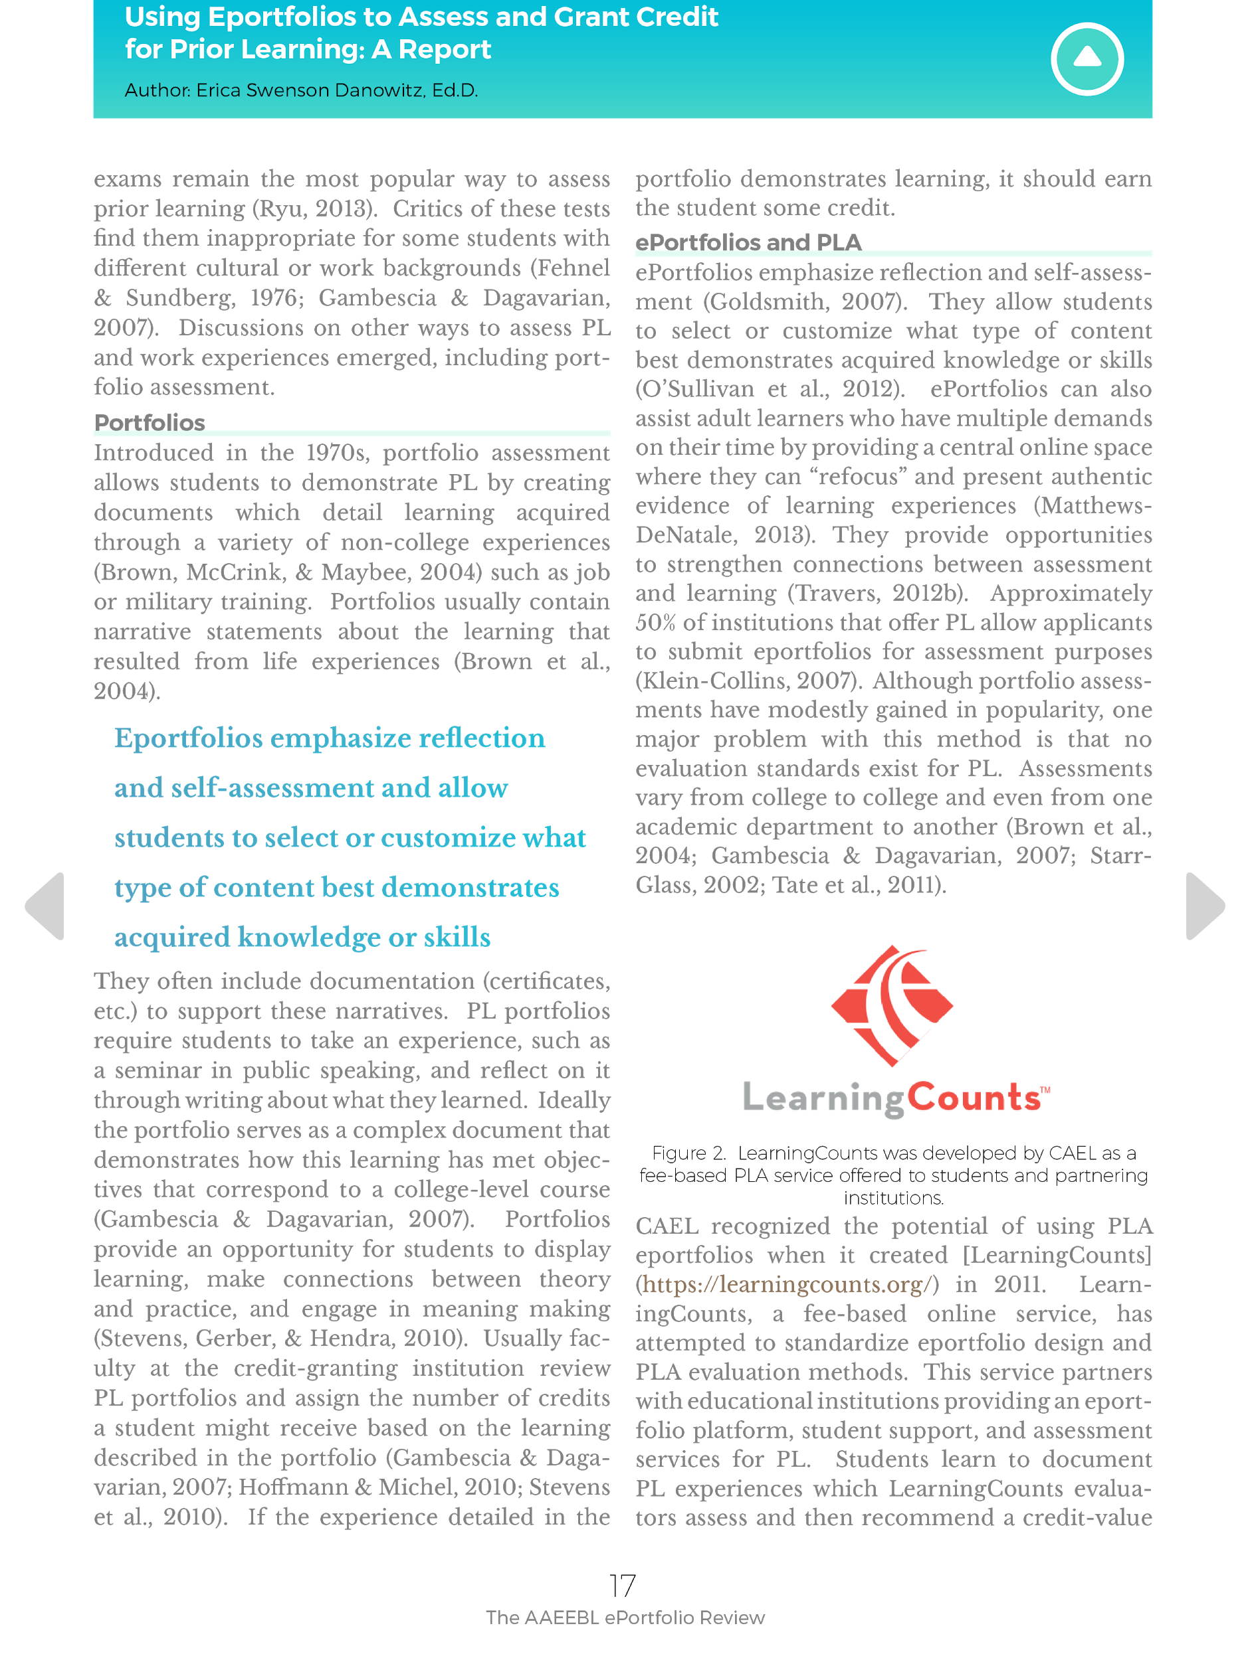

Slide 9
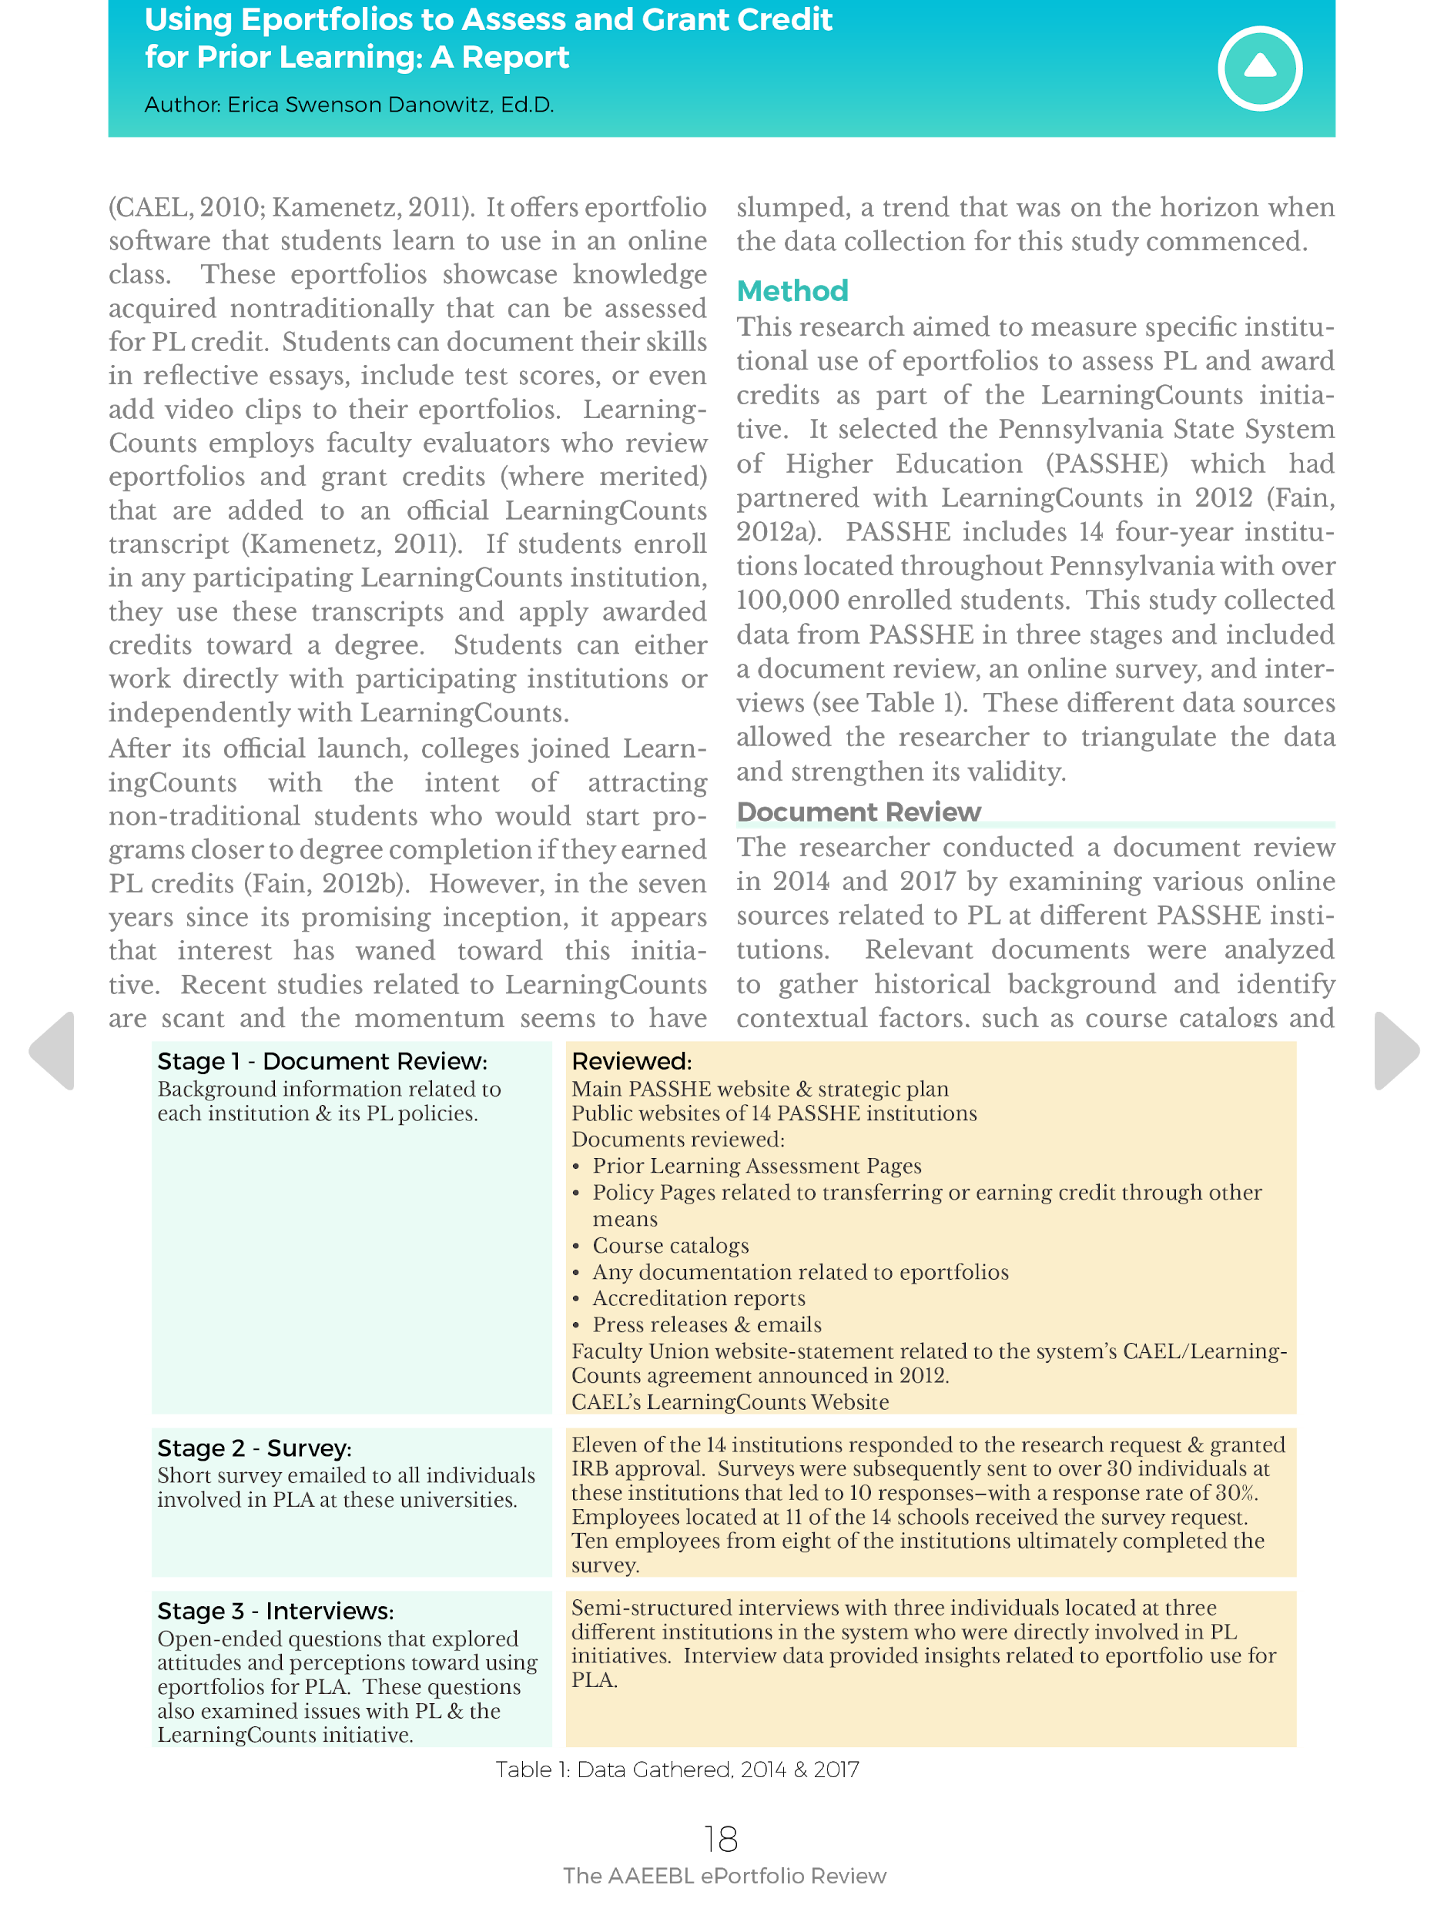
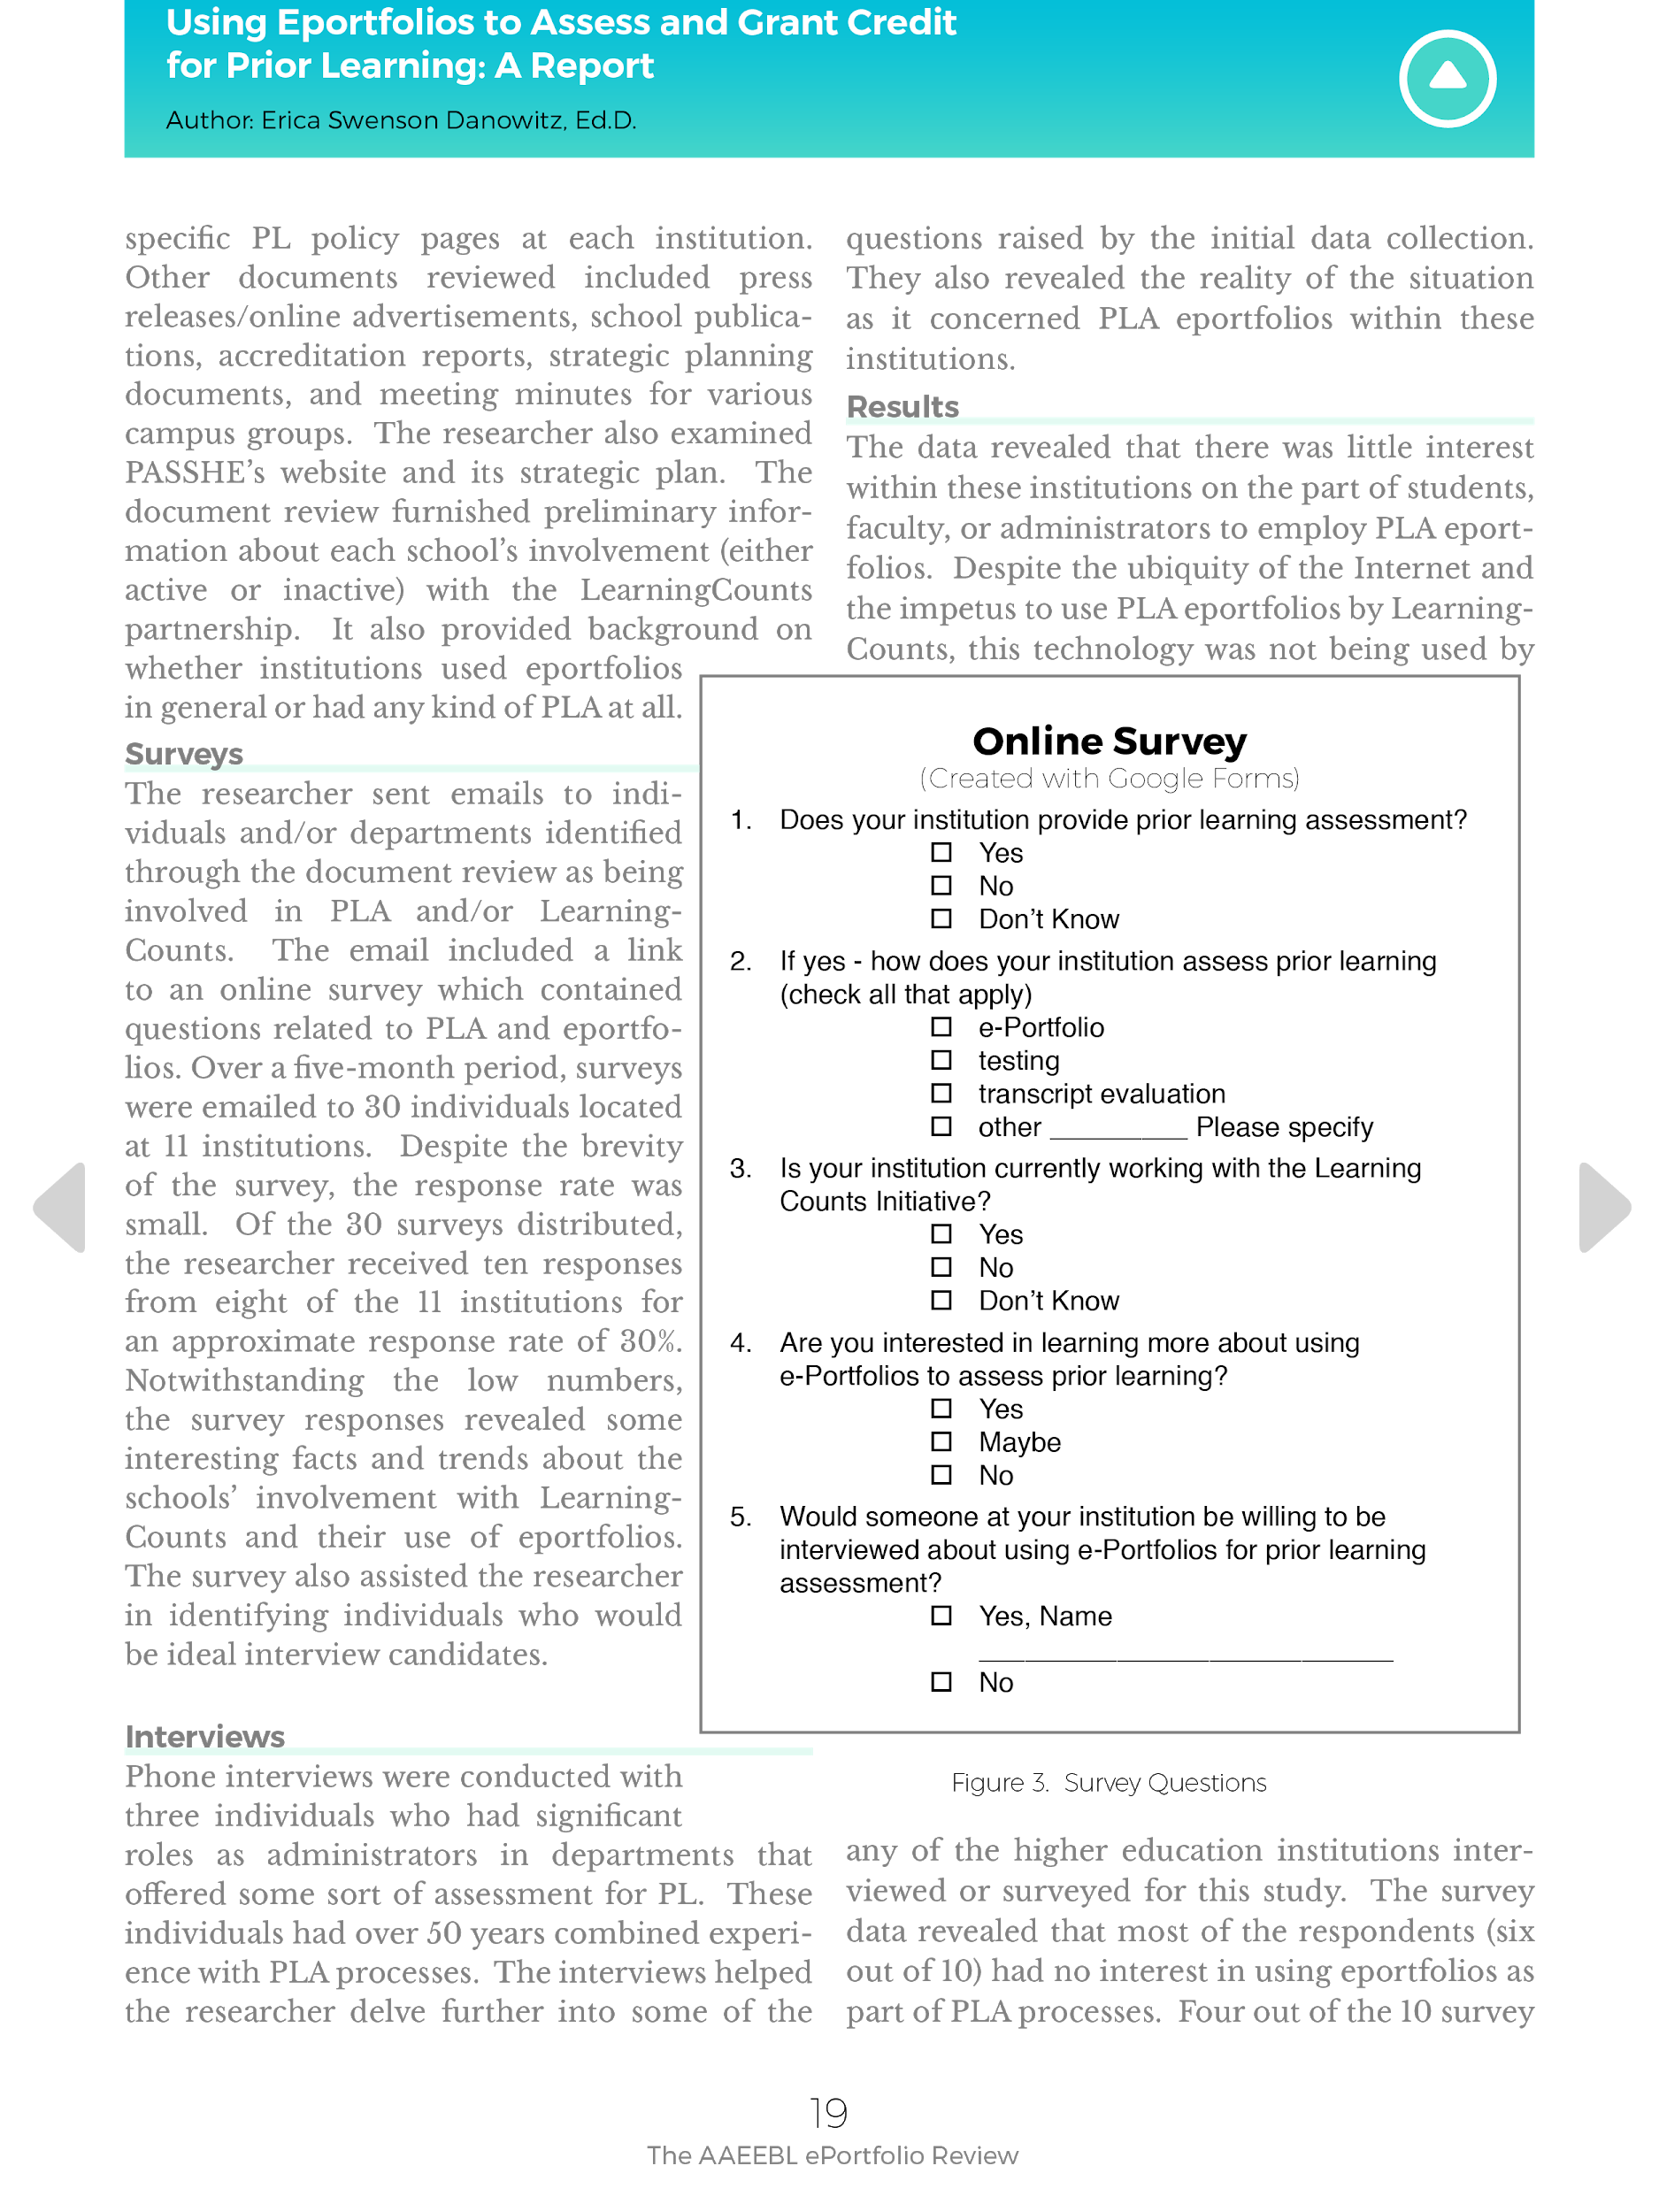

Slide 10
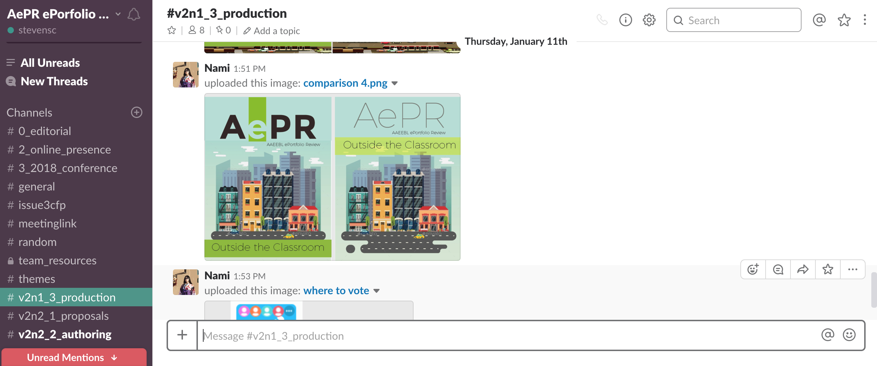
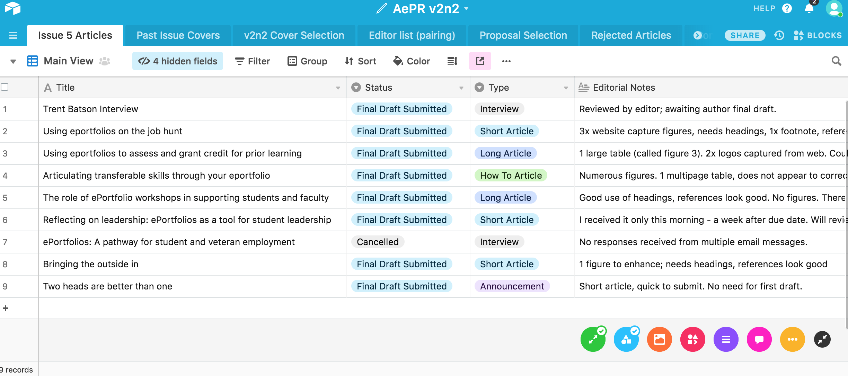
Multiple Tools
Zoom
Slack
AirTable
In-Design

Slide 11
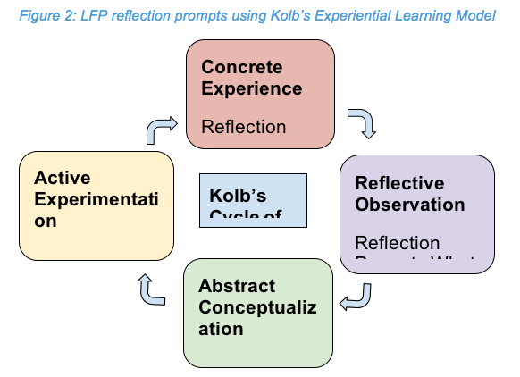
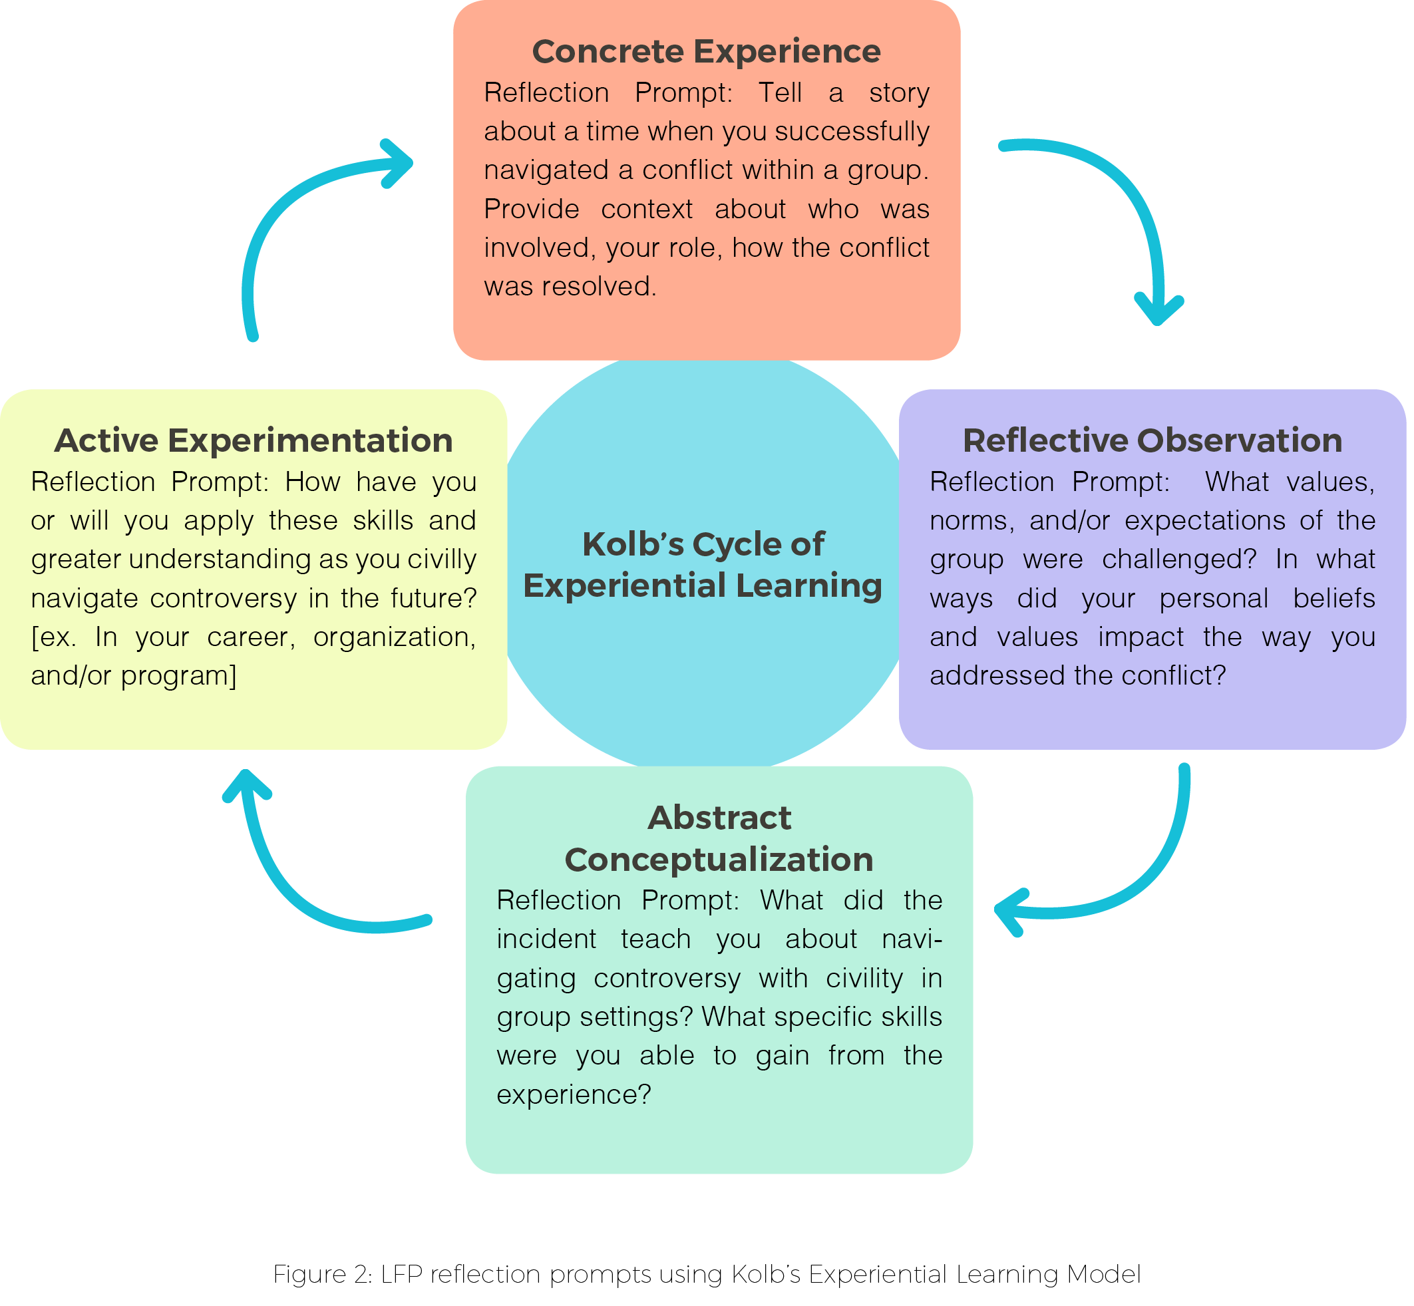
Figure Refinement
Original image was submitted in Word doc that was created using Word Tools and later refined in InDesign

Slide 12
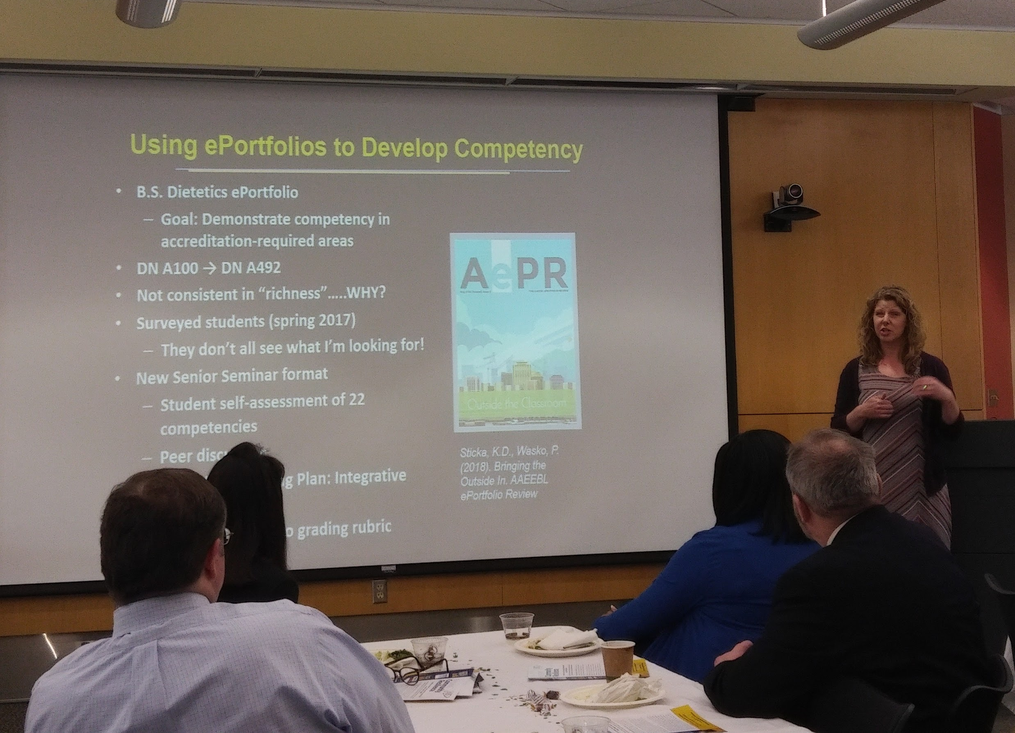
AePR in Action!

Slide 13
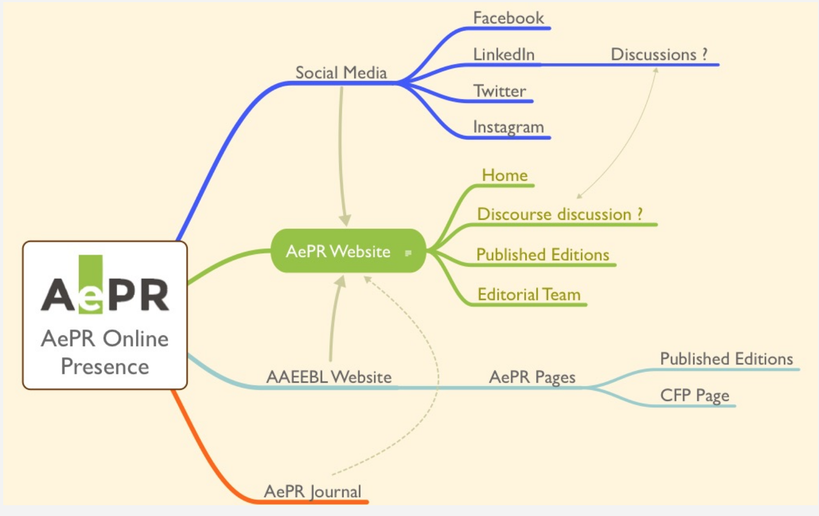
AePR Online Presence

Slide 14
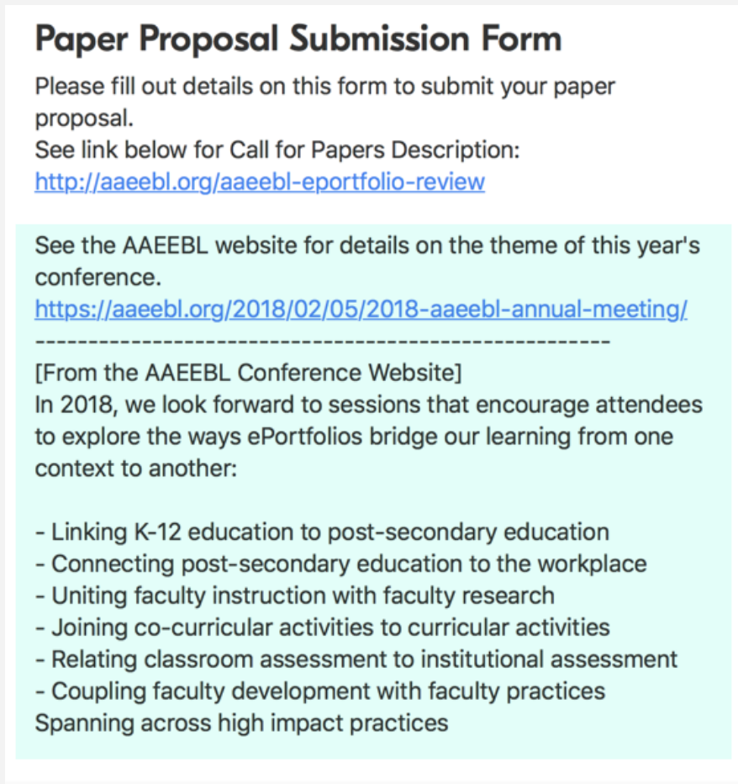
Submission Information
Two years/five editions
Seven to nine submissions each issue
Four rejections
Rejections invited for future editions based on the theme

Slide 15
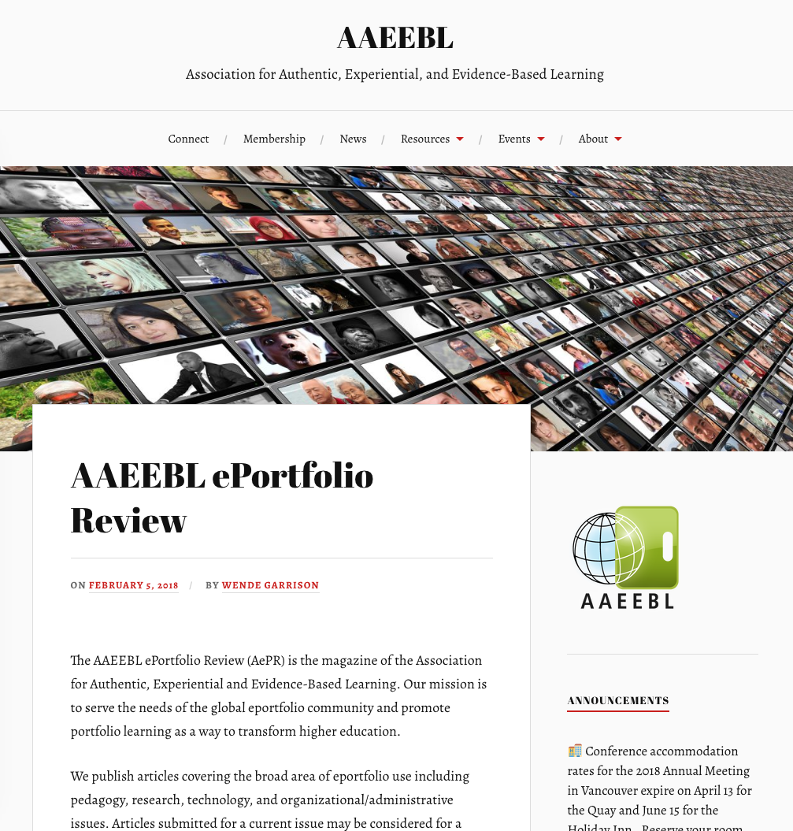

Slide 16
Landscape of Competing Journals
International Journal of Teaching and Learning in Higher Education
British Journal of Educational Technology
International Journal of ePortfolio

Slide 17
Landscape of Competing Journals
The International Journal of Recording Achievement, Planning and Portfolios
Educational Technology Research and Development

Slide 18
We Would Love to Hear from You!
Notes:
Overall impressions of AePR?
Usefulness of the articles?
Likelihood of contributing?
Content and themes?
Timeliness?
Suggestions for Processes/Operations?

Slide 19
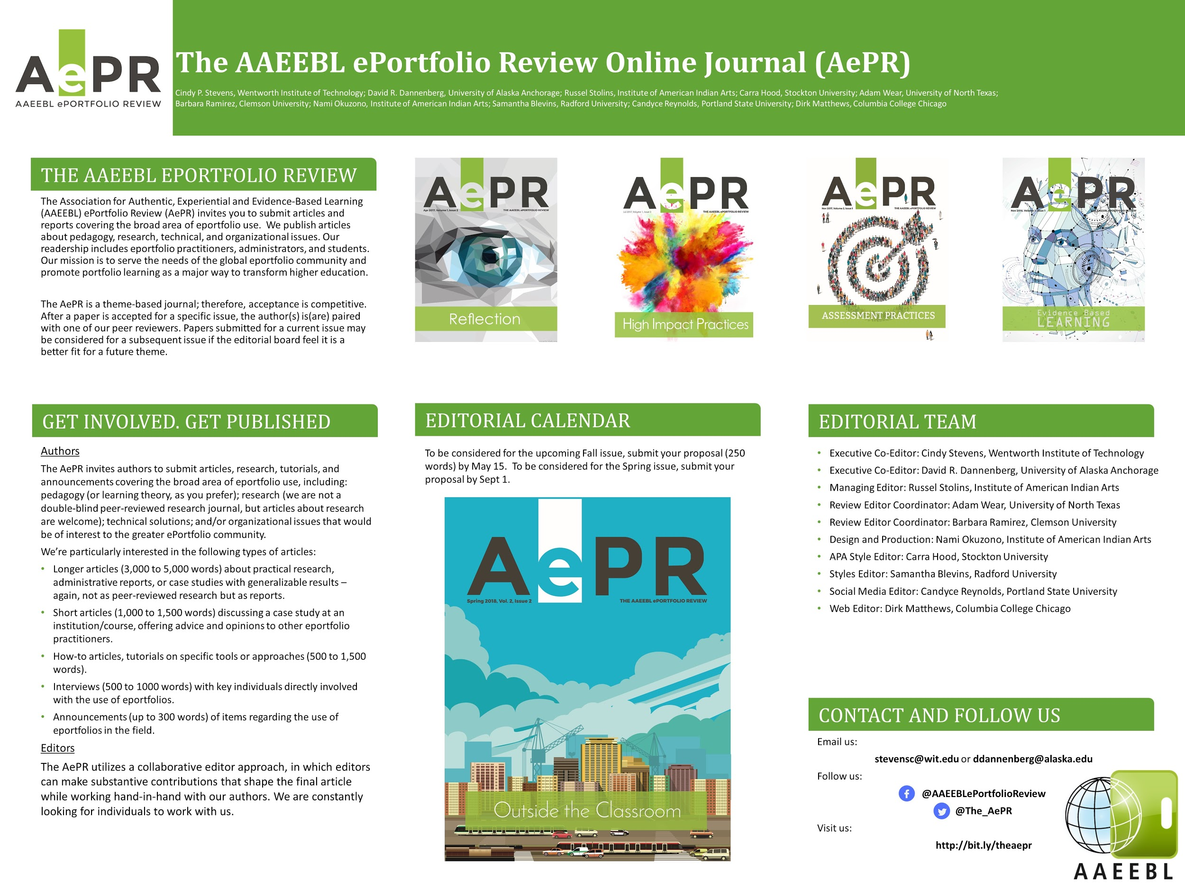
Stop by our Poster Session

